Slide 1
Microarchitecture Design & Operation
Suggested Reading: Chapter 4 from Tanenbaum, Structured Computer Organization, 5/6ed, Pearson

Slide 2
Layered Computer Organization
Problem-Oriented Language Level
Assembly Language Level
OS Level
Instruction Set Architecture Level
Microarchitecure Level
Digital Logic Level
Device Level

Slide 3
Instruction set architecture
IJVM

Slide 4
Objectives
By the end of this section, you will be able to:
List and work with the IJVM ISA instructions
Translate a subset of Java programs to IJVM ISA
Understand stack machines

Slide 5
JVM
javac: Java compiler
Compiles HL Java to Bytecode
Bytecode = Java Assembly (JAS) Language
JVM: Java Virtual Machine
Invoked by the java command
An interpreter of Java Bytecode

Slide 6
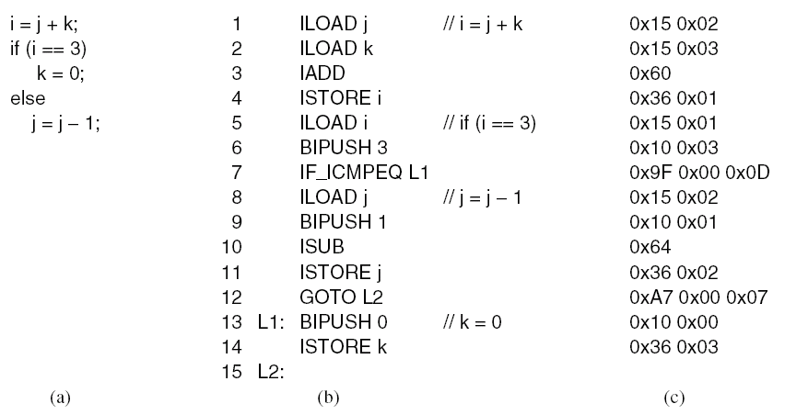
Java Architecture
Java code
void xyz() {
i = j + k;
if (i == 3)
…
}
javac
.java file
java
.class file
Hardware

Slide 7
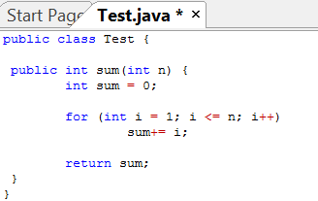
Example .java code

Slide 8
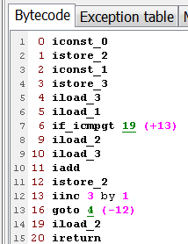
Example .class file

Slide 9
IJVM
IJVM: subset of JVM that deals with integers
No floating point instructions
All integer JAS opcodes are 1-byte long
Simpler to deal with

Slide 10
Stacks
JVM is a stack machine
Stacks are used to push local procedure variables
Local variable frame: data structure between LV and SP

Slide 11
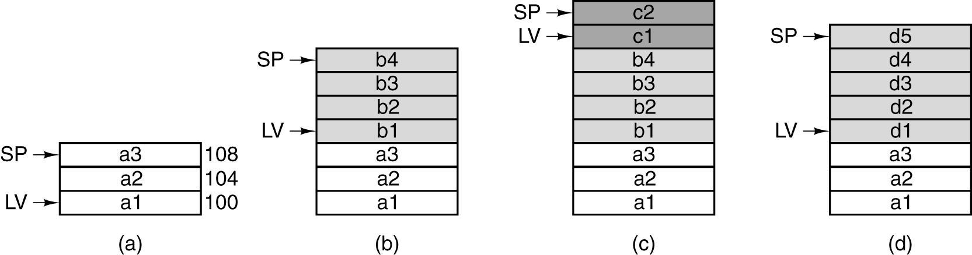
Local Variable Frame
Use of a stack for storing local variables.
While A is active.
After A calls B.
After B calls C.
After C and B return and A calls D.

Slide 12
Operand Stacks
JVM is an operand stack machine
Stacks are used to push operands during the computation of arithmetic expressions

Slide 13
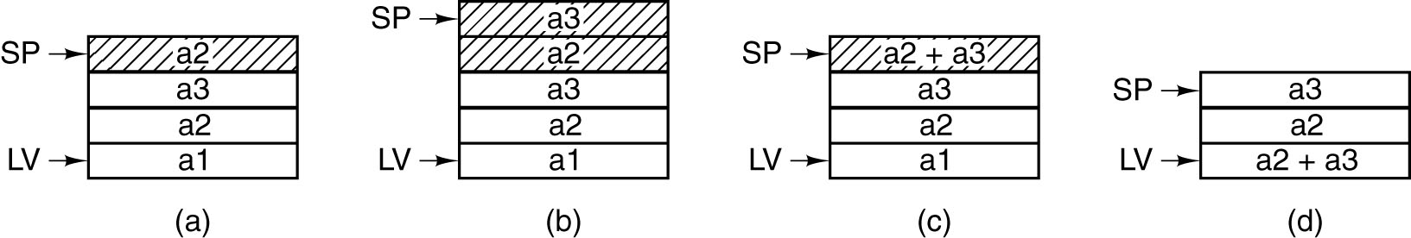
Operand Stack
SP
Use of an operand stack for doing an arithmetic computation
(a1 = a2+a3)

Slide 14
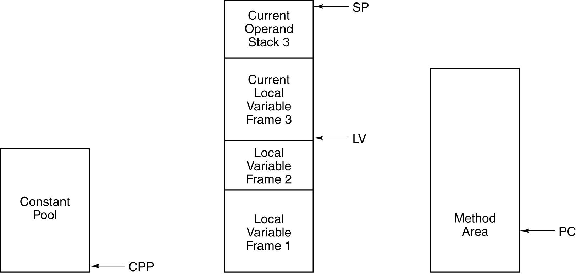
The IJVM Memory Model
The various parts of the IJVM memory.

Slide 15
Constant Pool
Constants, strings, & pointers to other areas of memory
Does not change after loading (cannot be written by IJVM program)
CPP contains the address of the first word

Slide 16
Local Variable Frame / Operand Stack
allocated to variables stored for the lifetime of a procedure
at the beginning of the frame: parameters
then, local variables
then operand stack
not true in general
LV points to the start of LVF
TOS = word at top of stack

Slide 17
Method Area
Program text
PC points to the instruction to be fetched next

Slide 18
Offsets
CPP, LV, & SP : word pointers
Offset is a word
LV+1: second word in LFV
SP: word on top of stack, SP – 1, next to top word
PC: byte address
Offset is a byte
PC+1: next byte is to be fetched

Slide 19
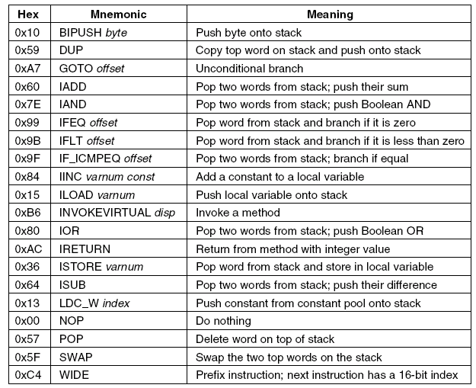
The IJVM Instruction Set
The IJVM instruction set. The operands byte, const, and varnum
are 1 byte. The operands disp, index, and offset are 2 bytes.

Slide 21
Compiling Java to IJVM
A Java fragment.
The corresponding Java assembly language.
The IJVM program in hexadecimal.

Slide 22
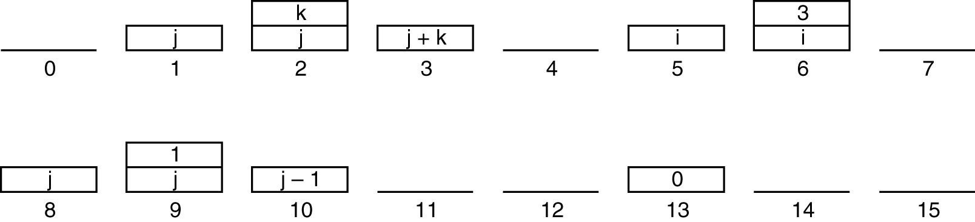
Stack When Executing Bytecode
The stack after each instruction of Fig. 4-14(b).

Slide 23
IVOKEVIRTUAL disp
Invokes another method
disp (16 bit) = position in constant pool that contains the address in method area where method starts
disp
CP
MA
address
Method
invoked

Slide 24
IVOKEVIRTUAL disp
SIMPLIFIED: cannot call methods except in same object
No Object-Orientation!
Caller:
Pushes OBJREF being called onto stack
Not needed for IJVM
Pushes method parameters
First parameter is param 1

Slide 25
IVOKEVIRTUAL disp
First 4 bytes of a method
First 2: number of parameters, including OBJREF (param 0)
Second 2: size of local variable area
Byte[0] Byte[1] = unsigned 16 bit int
disp
CP
MA
address
0
1
2
Byte[2] Byte[3] = unsigned 16 bit int
3
OPCODE1

Slide 26
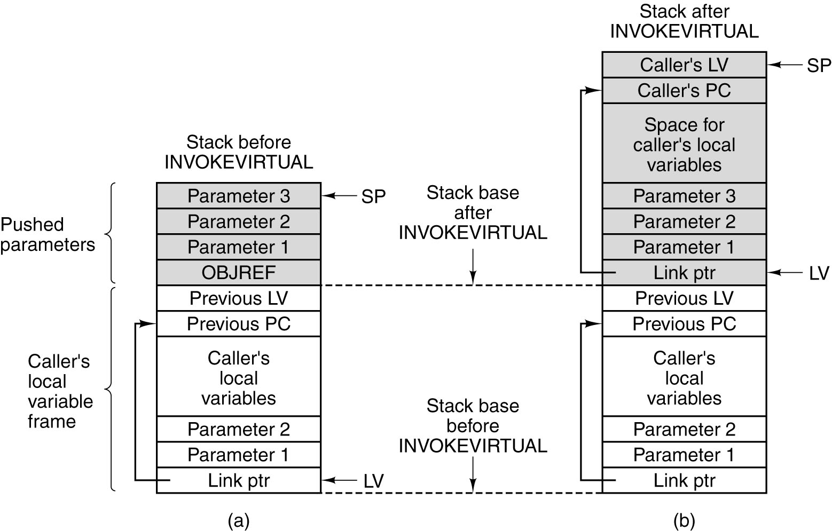
INVOKEVIRTUAL
PC = first Opcode in method area (5th byte)
Params + local vars
LV = SP - # of params
Memory before executing INVOKEVIRTUAL.
After executing it.

Slide 27
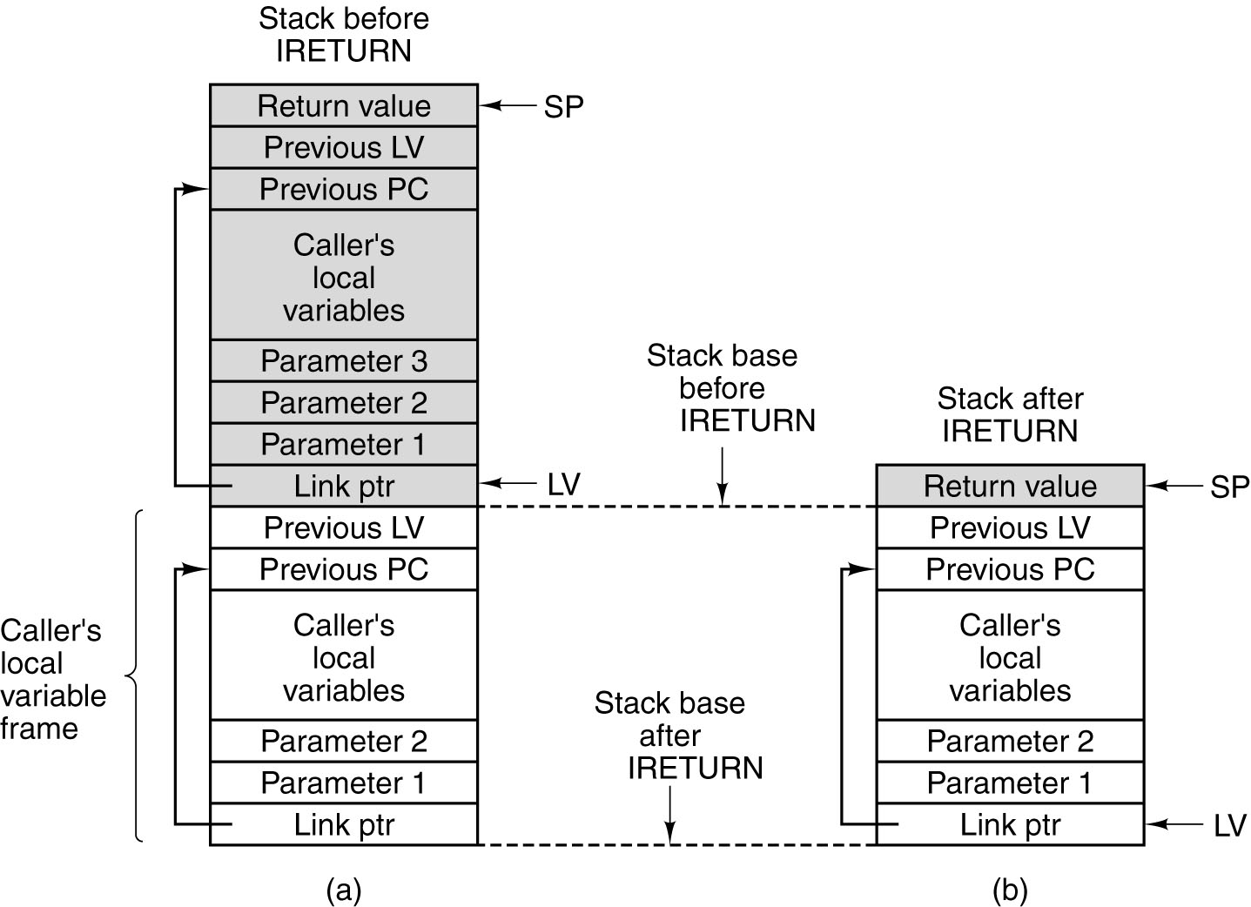
IRETURN
Control is returned to opcode immediately after INVOKEVIRTUAL
Restore LV and PC to old values
Memory before executing IRETURN.
After executing it.

Slide 28
Exercise
Convert the following HL Java code to IJVM
int j = 100
int s = 0
for (int i = 0; i < j; i++)
s += i

Slide 29
.main // main program
.var // local variables for main
i
j
s
.end-var

Slide 30
start:
BIPUSH 0x64 // 100
ISTORE j
BIPUSH 0x0
DUP
ISTORE s
ISTORE i

Slide 31
check:
ILOAD i
ILOAD j
ISUB // i - j
IFLT for_body // i < j
GOTO end
for_body:
// s += i
ILOAD i
ILOAD s
IADD
ISTORE s

Slide 32
// i++
ILOAD i
BIPUSH 0x1
IADD
ISTORE i
GOTO check
end:
.end-main

Slide 33
Input and Output Author: Dan Stone
.main
L1: IN // request character input from memory
DUP // duplicate top of stack (input char) for comparing
BIPUSH 0x0 // push 0x0 for comparison
IF_ICMPEQ L2 // if no characters are available for input, loop
OUT // else, print character
GOTO L1 // loop back to beginning of program
L2: POP // No key has been pushed, so clear the stack,
GOTO L1 // and start over
.end-main

Slide 34
Defining Methods in JAS typically after main
.method methodName()
.var
variables
.end-var
body
…
IRETURN
.end-method

Slide 35
Calling Methods in JAS
LDC_W OBJREF
INVOKEVIRTUAL methodName
Before .main, you need:
.constant
OBJREF 0x40
.end-constant

Slide 36
Calling Methods with Parameters
LDC_W OBJREF
ILOAD param1
ILOAD param2
INVOKEVIRTUAL methodName

Slide 37
Using LDC_W
// this program displays all the printable ASCII values 32..126
.constant
one 1
start 32
stop 126
.end-constant
.main
LDC_W start
next: DUP
OUT // output the current character
DUP
LDC_W stop
ISUB IFEQ done // exit if we've reached the end
LDC_W one
IADD
GOTO next // increment and do the next one done
POP
HALT
.end-main

Slide 38
Exercise
Write a JAS method int sum(int n) that calculates and returns the sum of integers up to n,

Slide 39
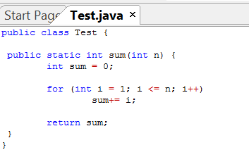
HL Java code (static method)

Slide 40
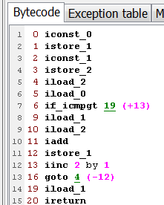
JAS code
iconst loads a constant to the stack
sum is var 1
i is var 2
Parameter n is var 0
Using Jclasslib byte code viewer

Slide 41
HL Java code (instance method)

Slide 42
JAS code
Static
Instance
Variables are shifted by 1, since var 0 is OBJREF

